Slide 1
SOCIAL BUZZ
Data Insights

Slide 2
HELLO,
I’m Anthony Cusimano.
I am the data analyst for this project and will present key insight into the content posted on Social Buzz.

Slide 3
DATA HIGHLIGHTS
Animals
Audio
January
Most popular post category
Content type with most positive ratings
Month with the most posts

Slide 4
KEY TARGETS TO ACCOMPLISH
IPO Completion
Guidance to ensure a smooth IPO process
Scalability
Experienced assistance to manage Social Buzz’s rapid growth
Data Practices
Instruction on the best ways to handle big data
What can we do when there are already over 100,000 new posts each day?

Slide 5
LET’S START BY ANALYZING CURRENT DATA
Data Cleaning
Visualization
Analysis and Insights

Slide 6
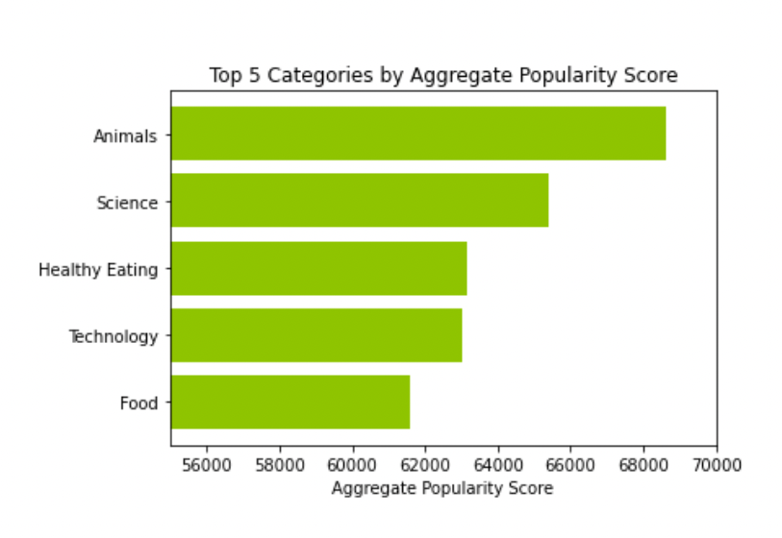
WHAT ARE THE MOST POPULAR CATEGORIES?

Slide 7
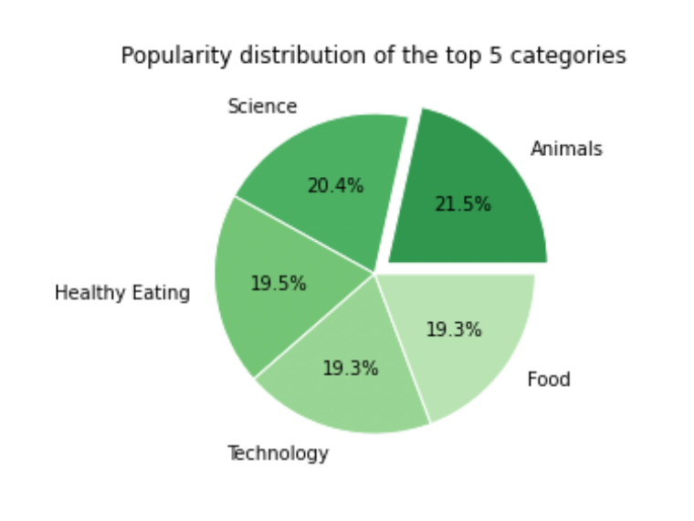
MAKEUP OF THE TOP 5 CATEGORIES

Slide 8
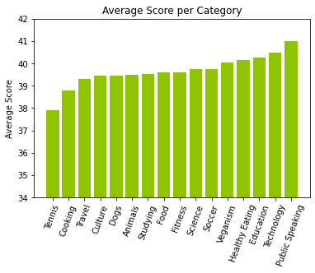
WHAT POSTS GET THE HIGHEST SCORE ON AVERAGE?

Slide 9
WHAT CAN WE TAKE AWAY?
Most Engagement
Animals, Science, Healthy Eating, Technology, and Food have the most post reactions
Best Overall
Technology and Healthy Eating are both in the most posted categories and are in the top 5 for average scores per post

Slide 10
WHAT NEXT?
These insights help us understand Social Buzz’s user base but, with full-scale analysis, we can dig deeper.
We can show you how!

Slide 11

THANKS!
We hope these insights make you confident in our understanding of your business.

